Slide 1


Social Media Threat Intel Platform

Slide 2

Contents
A better story
A naïve attempt with Naïve Bayes
Word2Vec – A new hope
Results and Analysis
Extending the use case to Threat Intel
Proposed solution flow chart
Business case
Future work

Slide 3
A better Story
Solution based approach
System development is in infancy stage
Early feedback and comments leads to better system design

Slide 4
A naïve attempt with Naïve Bayes
Attempt to classify tweets as security threat or not in the summer of 2016
Lack of Security knowledge source
Unigram approach will not identify “Denial of service” as one word
Can not relate Microsoft to its products

Slide 5
Word2Vec – A new hope
Another Attempt in the fall of 2016
Automatic Labeling for Entity Extraction in Cyber Security from Stucco used Relevant Terms Gazetteer (Oak Ridge National Laboratory)
Information extraction of security related entities and concept from unstructured text (UMBC) uses Stanford NER – Supervised learning -2013

Slide 6
Word2Vec – A new hope Contd.
A neural network algorithm designed by Google
Unsupervised learning
It was recently shown that the word vectors capture many linguistic regularities can identify products of Microsoft
From words to phrases and beyond, can identify “Denial of Service”

Slide 7
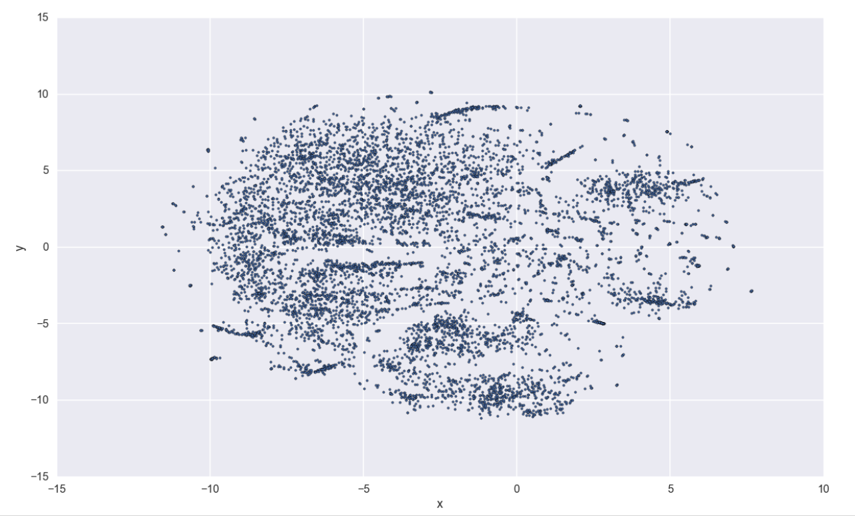
Results and Analysis
NVD dataset from January 2010 through March 2013
Contains 1,656,837 tokens
Notes:
Source : https://github.com/ShashSec/SMTI_SA/blob/master/NVD-WordtoVec.ipynb

Slide 8
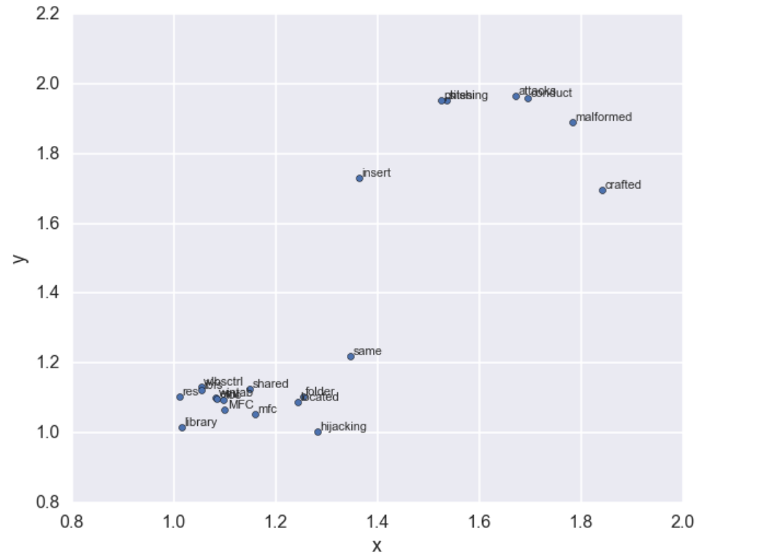
Results and Analysis Contd.

Slide 9
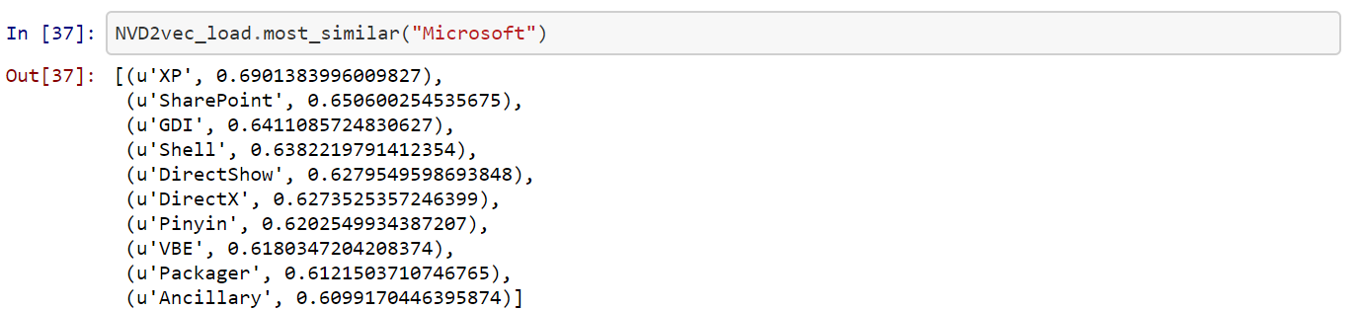
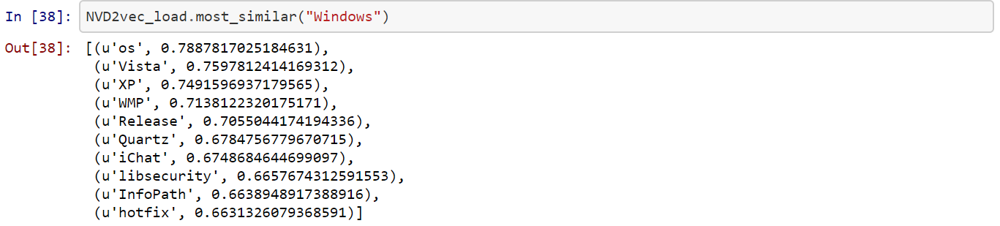
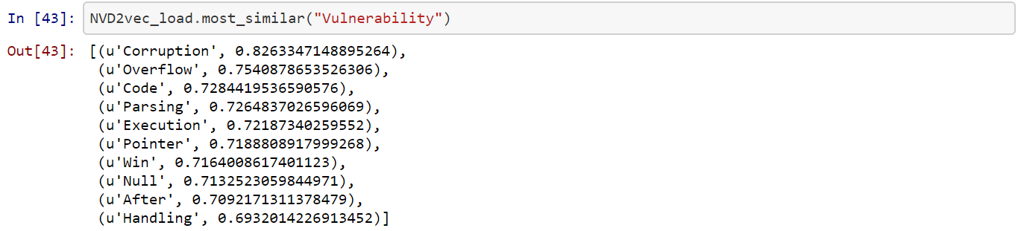
Results and Analysis Contd.

Slide 10
Extending the use case to Threat Intel
Many tools provides platform to find threat or security related information in social media
Adopting deep learning algorithms in these platforms
Designing robust and versatile social media threat intel platform using deep learning techniques

Slide 11








Proposed solution flow chart
Repository of predefined problem models
Client
RFI
Selects one or more
data source
Selects predefined problem model or train a new model
Security Analyst
new problem model trained by the Analyst. Approx. 3 to 5 hrs.
Aggregates and displays the result

Slide 12
Business case
Less time to train the model
One model can serve multiple clients

Slide 13
Future work
Use large NVD dataset to train the model
Use various social media data like tweets to train the model
Develop a case studies

Slide 14

Thank you!!
Questions??

